Slide 1
First Sprint
Team RCM
By: Ramiro Gamboa Montes, Christopher Ramirez, Maggie Hemond

Slide 2
Back-End
Python for requesting stock data from yfinance. Which is then "wrapped" in render, our hosting application. Front end is made with react (js)
Render(Hosting)
REQUEST
Python
Backend
Frontend
React (JS)
RESPONSE

Slide 3
Back-End: Current Development
Backend handles one stock per API call (20 stocks = 20 calls). Can be slow, but most important, it works!
API Site link: https://stock-api-2rul.onrender.com/
API How to use and example use: Argument taken as processed is AFTER the "=" sign at the end.
https://stock-api-2rul.onrender.com/stock?symbol=NVDA returns Nvidia stock information
https://stock-api-2rul.onrender.com/stock?symbol=AAPL returns Apple's stock information

Slide 4
Back-End: Future Plans
Multi-Stock Requests: Consider an endpoint that accepts multiple symbols (Ex.) /stocks?symbols=NVDA,AAPL,TSLA) to reduce HTTP overhead.
Data Size: Even 50,000 words (~500 KB) is manageable due to text compression and common server limits. So, we should be able to get away with larger data requests from the server.
Scalability & Real-Time Updates: Perhaps fetch stocks in batches (Ex.) 20 at a time), perhaps with lazy loading. Perhaps use an intermediate read-only database to serve frequent requests and reduce API calls.
Additional Considerations: Implement rate limiting and caching strategies to prevent overwhelming the API (realistically, not need for this project, but you may never know)

Slide 5
The pages we have created
There are four pages with the same navigation bar.

Slide 6
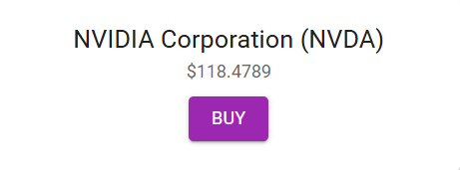
Connecting React Frontend to the API
API Endpoint & JSON Data: The Flask backend exposes an endpoints (Ex. /stock?symbol=NVDA) that returns stock data in JSON format. JSON data includes essential fields like symbol, name and current price.
HTTP Request Using Fetch: The React frontend uses the fetch() method to make an HTTP GET request to the API endpoint.

Slide 7
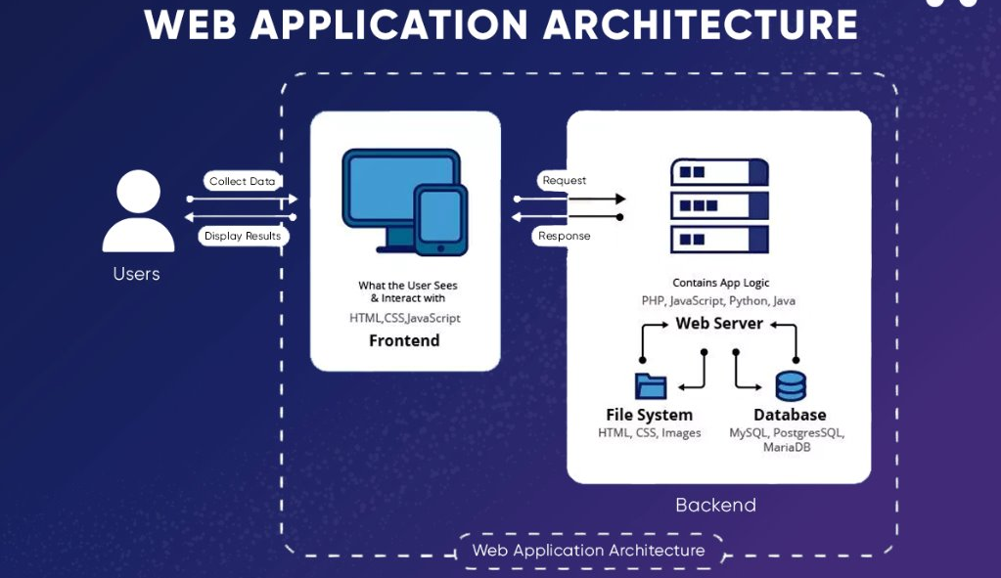

Slide 8
Future connection plans
API Security: Currently, the API endpoint is public; implement authentication to restrict access.
Code example of how it is currently done: Anybody with the link could spam the API for calls over and over if they wanted.
*************************************************************************************
fetch("https://stock-api-2rul.onrender.com/stock?symbol=NVDA")
.then(response => response.json())
.then(data => console.log("Stock Data:", data))
.catch(error => console.error("Error fetching stock data:", error));
*************************************************************************************
Simple test code, prints current API call to console

